Slide 1
WŁAŚNIE TU

Slide 2
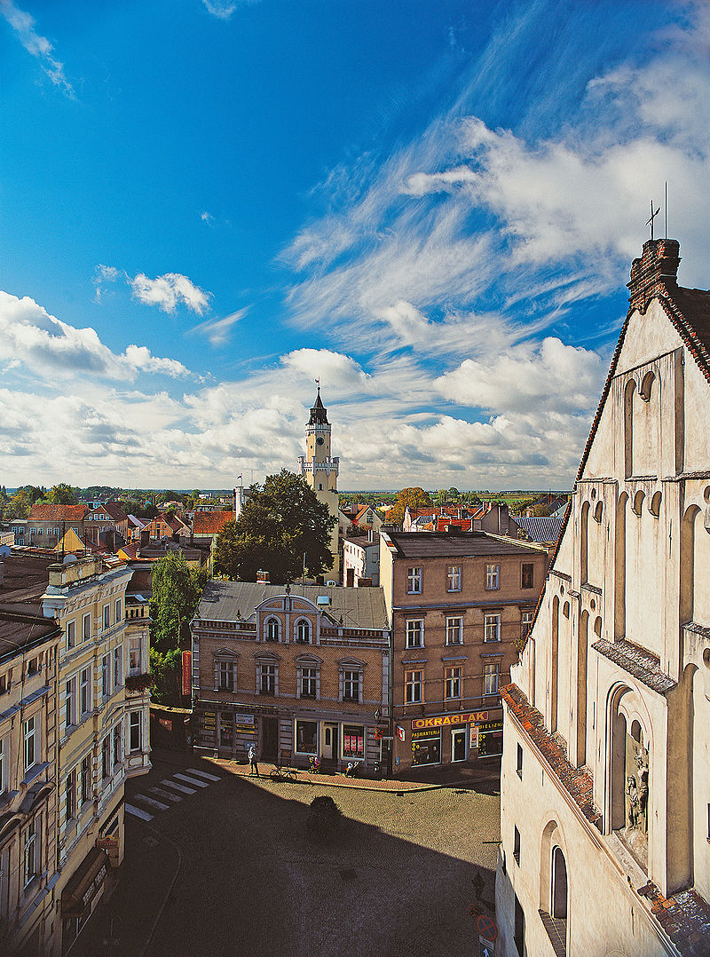

Właśnie tu.
WSCHOWA
Wschowa (pronounced Fs-hova [ˈfsxɔva], German: Fraustadt) is a town in the Lubusz province in western Poland with 13,875 inhabitants (2019). It is the capital of Wschowa County and a significant tourist site containing many important historical monuments.
The historical background of Wschowa dates back to the year 1136, when it was first mentioned in the bull of the Pope Innocent II. In the 18th century it used to be one of the biggest cities in Poland, referred to as an unofficial capital of Poland, as Polish kings used to reside here, also the Senate meetings used to be held.
Wschowa used to be a safe haven for persecuted Lutheran protestants, and its location in the melting point of Slavonic and western cultures, and also crossing of trade routes resulted in the town's multicultural character, and co-existance of various religions and nationalities.
2

Slide 3
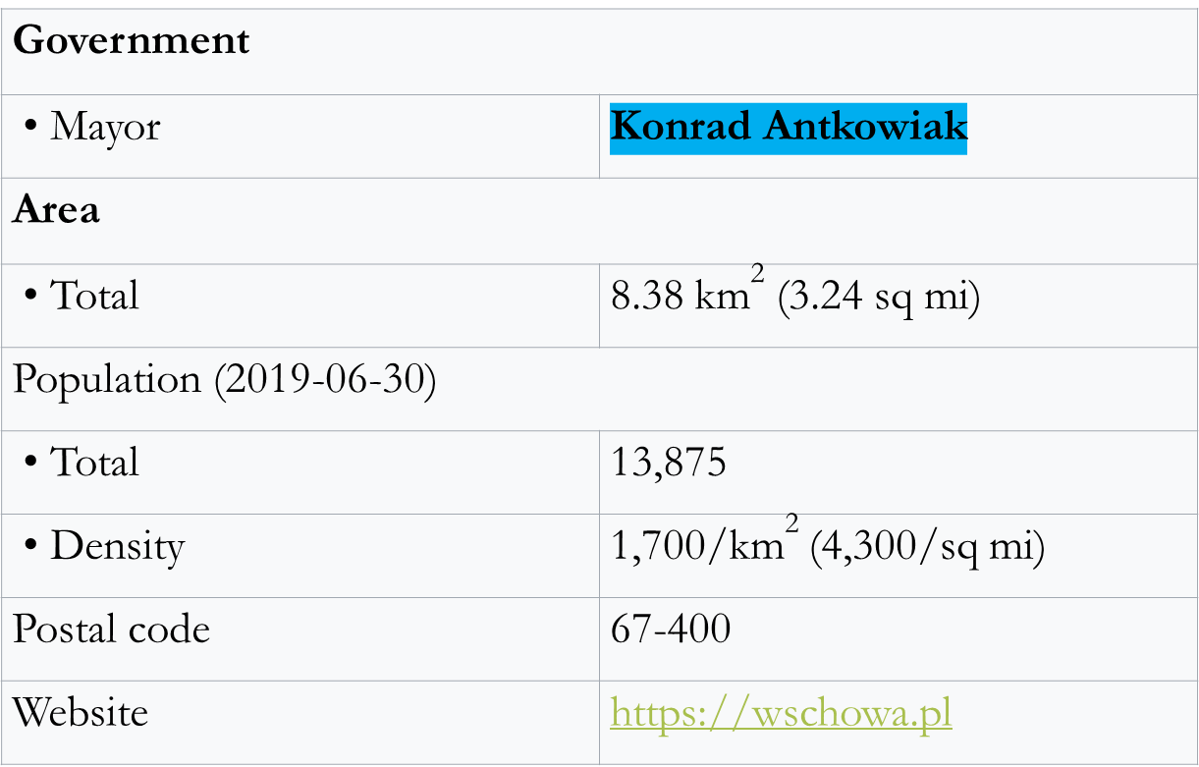
Właśnie tu.
WSCHOWA
3

Slide 4
Właśnie tu.
WSCHOWA
ABOUT THE WSCHOWA MUNICIPALITY
The Wschowa commune is located in the south-eastern part of the Lubuskie province. The Wschowa community covers an area of ​​19,691 ha, including the city - 925 ha.
Its northern part is covered by the national system of protected areas, which includes a fragment of the protected landscape area:
Przemęcko-Wschowski Area, in which the Przemęcki Landscape Park is located.
This park was established to protect unique forest, meadow and lake complexes in terms of nature and landscape, with many species of protected and often rare plants and animals.
The boundaries of the protected landscape in the commune include mainly forest complexes. There are three lakes in the commune, the largest of which is Lake Lgińsko, located approximately 10 km from Wschowa.
The lake area is 68.6 ha, volume 4,778.3 thousand. m3, maximum depth 16.9 m, average depth 7.0 m.
The lake is intensively used for recreational purposes thanks to the picturesquely located beach.
In the close vicinity of Lake Lgińsko there is Lake Lginko (Lgiń Mały) with an area of ​​39.10 ha, volume - 1,422 thousand. m3, maximum depth 7.2 m, average depth 3.6 m.
Moreover, within the commune there is Lake Dąbie with an area of ​​13.56 ha in the village of Wygnańczyce.
4

Slide 5
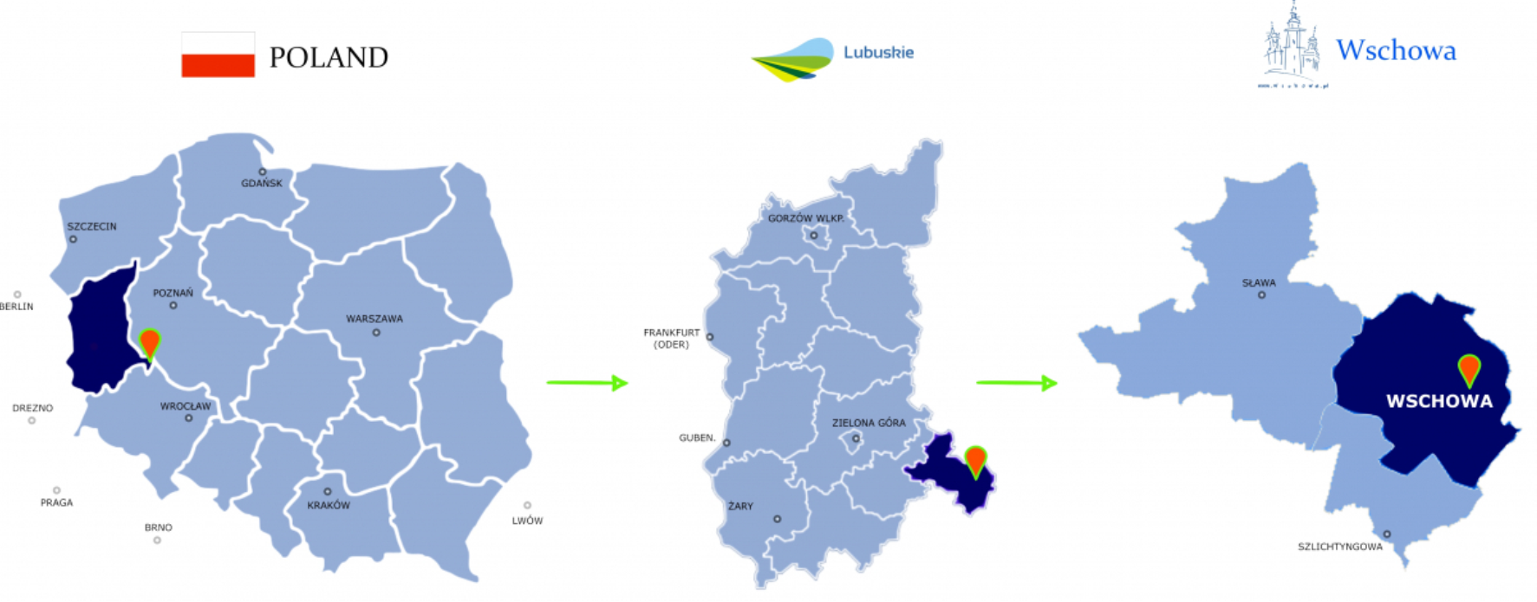
Właśnie tu.
WSCHOWA
5

Slide 6
Właśnie tu.
WSCHOWA
CULTURAL AND EDUCATIONAL POTENTIAL
Currently there are three institutions whose goal is to provide wide offer in the area of culture and sports:
- The Public Library of the Town and Commune, which is located in the historic building of the former Jesuit Residency.
- Museum of the Land of Wschowa, pursuing numerous educational projects, museal classes, workshops, organization of events within the framework of both nationwide and local projects, promotion of books, lectures, as well as seminars and conferences.
- Culture and Recreation Centre, which is organizing a number of events in the area of culture, entertainment, and sports. Special interest clubs are also present, as well as are classes in arts, theatre and singing, chess club, „Sedno” literature and music ensemble, the „Lutnia” choir, bridge club.
Within the borough there are several education facilities: kindergartens, primary and secondary schools with wide educational offer.
Some creches and kindergartens are private entities.
It is worth mentioning that in Wschowa there is the State School of Music of the First-Tier.
6

Slide 7
Właśnie tu.
WSCHOWA
ECONOMY
The economy of our commune and the town itself is services-oriented. Industry is located in the suburbs, and companies represent the small and medium-size range. There are no factories and mass-production entities, although there are industrial zones with buildings and premises which once used to belong to well-doing companies. One of the largest and most active companies in our township is a Swedish company STENA Recycling; they are expanding their premises in Wschowa and are becoming one of the most modern companies in the recycling industry in Europe.
The citizens of the town and villages are working services, administration, schools, small private family businesses, shops and supermarkets, a hospital and health care facilities. In the rural areas people work in agriculture and horticulture. Conditions for agricultural industry are one of the best in Poland. Tourist industry is not well developed despite tourist attractions - picturesque lakes, green areas with minimally developed tourist facilities. For the years to come our plans cover development of cycling paths, renewed sports facilities, and local swimming pool with extended recreation part.
7

Slide 8
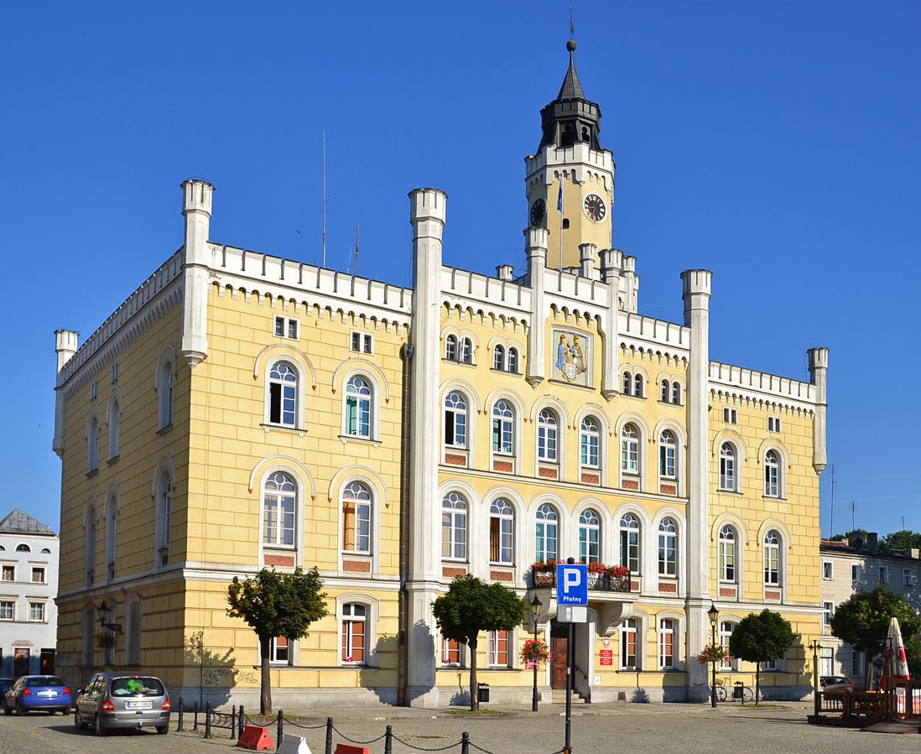
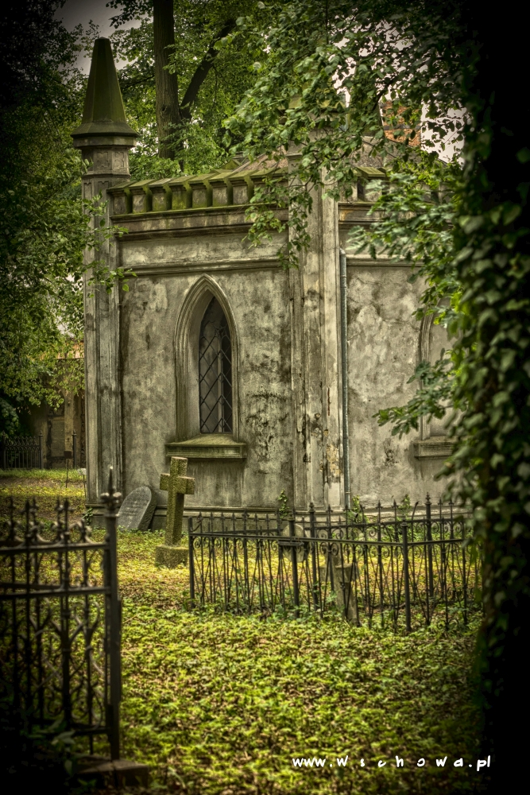
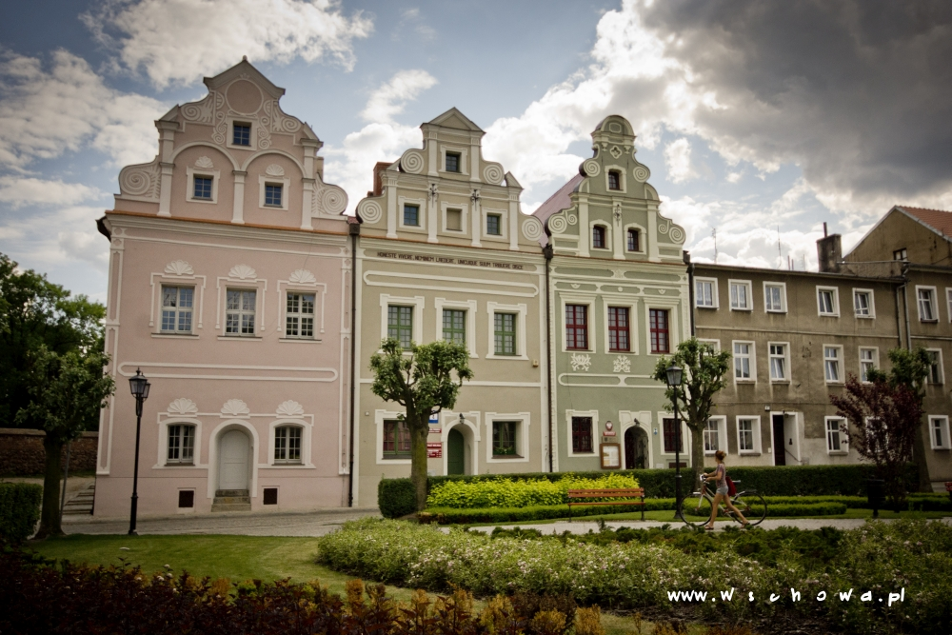
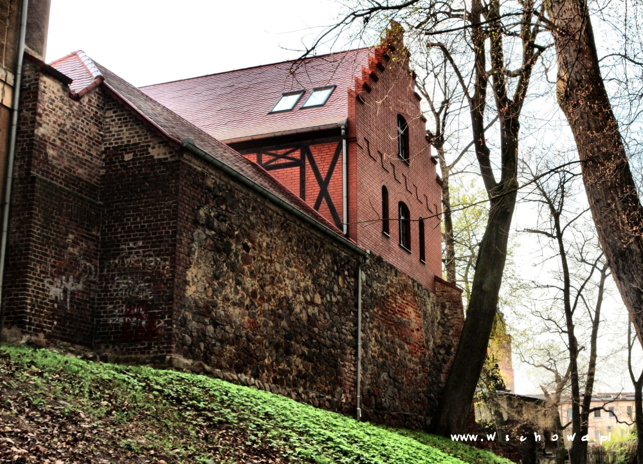
Właśnie tu.
HISTORY
WSCHOWA
The town centre has several interesting historic sights, varying from 15th century ramparts to baroque buildings and churches. Some good examples include:
The monument is a valuable example of medieval town fortifications, which include preserved fragments of defensive walls, gate tower, as well as a moat and rampart, converted to a promenade and parks in the 19th century.
The partially reconstructed sections of the walls and the fortified tower emphasise the character of the medieval complex.
The town hall is an interesting and valuable monument, in which the alterations in the Gothic Revival style match the architecture of the body designed in the Gothic style.
The present-day town hall is the result of the reconstruction done in the Gothic Revival style in 1860-1870.
Lutheran cemetery - was founded in 1609 as the evangelic cemetery. It is rectangular in shape and refers to the Italian style cemeteries (so called Camp Santo – Holy Fields).
Near the market square and Zamkowy Square there are tenement houses with fronts and tops.
8

Slide 9
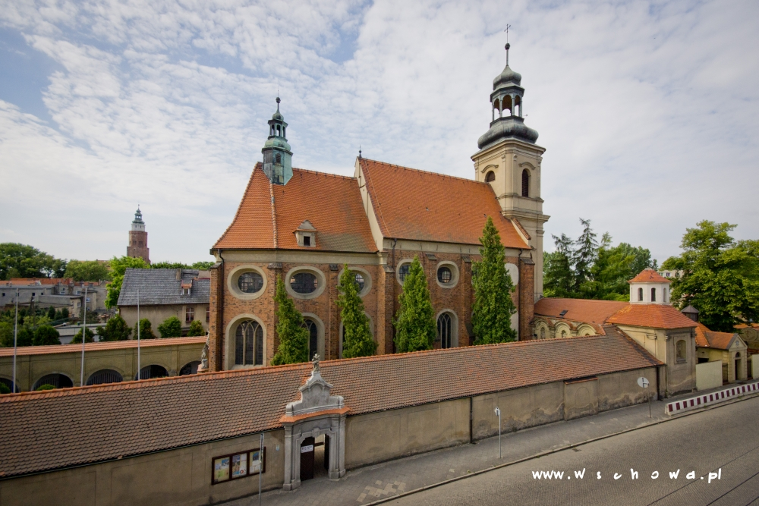
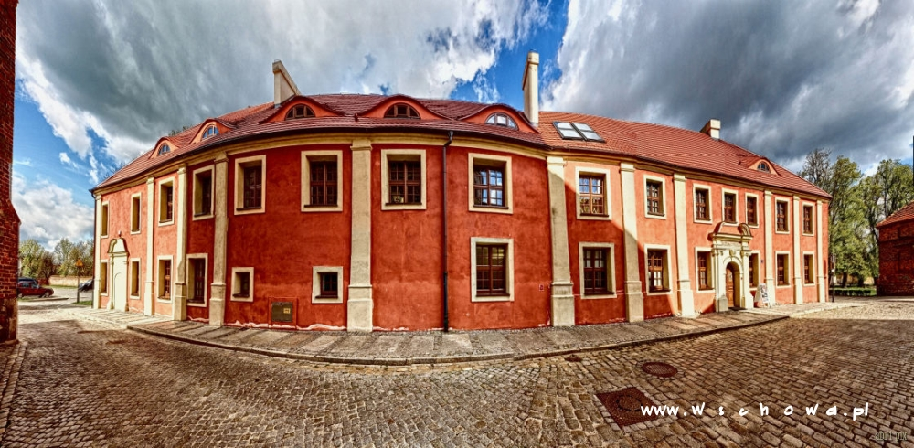
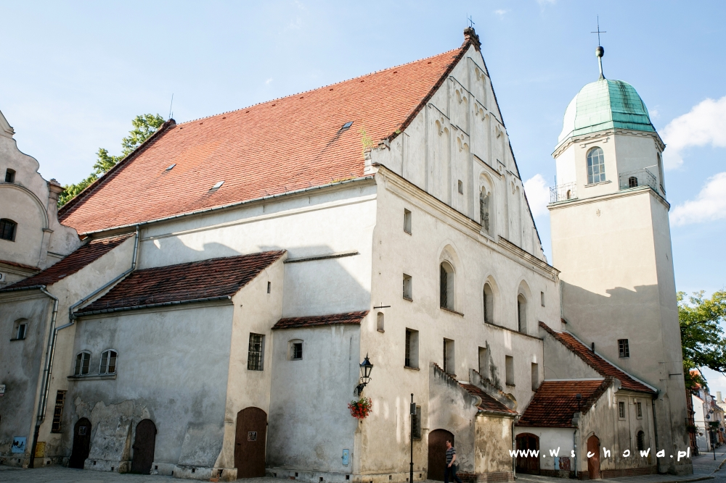
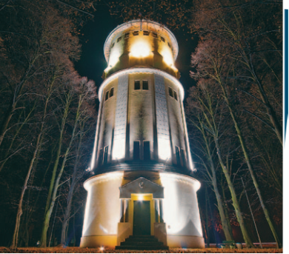
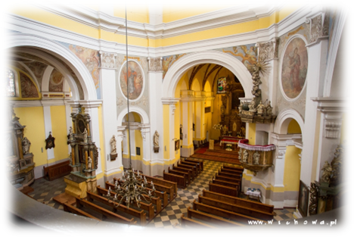
Właśnie tu.
WSCHOWA
Monastery of the order of St. Francis. This monastery is just outside the old town and was built by the order of the St. Bernardyns. It was burned to the ground at least twice. The current structure originates in the 17th century. Today, it is owned by Franciscan monks. It houses a church dedicated to St. Jozef and a chapel.
The Jesuits were brought to Wschowa around 1720. The school for young people from noble houses was opened in 1729. In 1797 the building was seized for military purposes. In 2013, the renovated building was handed over for the purposes of the Municipal Public Library and the Museum of the Wschowa Land.
The Water Tower in Wschowa is an example of employing new solutions in municipal architecture. The tower, looming over the horizon (36 metres high) to this day performs its function. The tower can be seen at night thanks to illuminations.
Parish Church (Kościół Farny) - originating in the 15th century, this pretty parish church was restored and altered at the end of the 17th century.
The Evangelical congregation, coming from the 17th century, constitutes a valuable monument of Protestant sacred architecture, with uniform, consistent form.
The building is not in use, but may be visited upon prior telephone appointment.
9

Slide 10
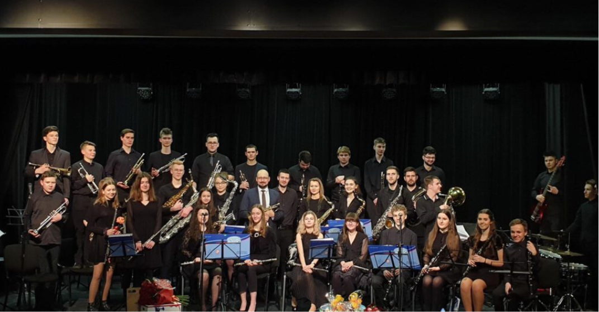
The Wind Instruments Young Orchestra was founded in 2005 by the Association of Wschowa’s Culture. The Orchestra plays concerts both in the country and abroad.
Workshops take place regularly.
Właśnie tu.
WSCHOWA
CULTURAL ACTIVITIES
The Polish Scouting and Guiding Association (ZHP) in the Wschowa County was founded in 1950. The main mission is to educate young people, that is to support them in their full development and character formation by posing challenges, bringing together Children and Youth.
The Majorettes performance group "Finezja" that are active with the Association of Wschowa’s Culture. They are recognised as one of the best bands in Europe and worldwide, successfully competing in international contests.
10

Slide 11
Lgiń, is a sports and relaxing backup of Wschowa, In the summer it is frequently visited by the inhabitants of the town and the county as well as by lots of tourists. Lgiń is situated 10 km from Wschowa, on two lakes – Lgińsko (the Big Lgiń, an area of almost 69 ha) and Lginko (the Little Lgiń, an area of about 39 ha).
Właśnie tu.
WSCHOWA
CLEAN LAKES, FOREST SECTIONS AND WILDERNESS
It is worth touring the further neighbourhood of the town and the county. These parts are particularly recommended for tourists and active rest lovers especially keen on cycling, hiking and water trips. People who are fond of sailing cruises and kayaking will be delighted to visit the Przemęt Landscape Park situated in the direct neighbourhood. Within that area, there are 24 proglacial gully lakes, two water routes (the Lily of the Valley Route and the Cistercian Kayak Route).
11

Slide 12
Vision of the Town and Commune of Wschowa
Właśnie tu.
WSCHOWA
Mission of the Town and Commune of Wschowa
Facilitating sustainable development, care of local society and environment, as well as offering areas of economic development, and for leisure activities. Being a town and community that is friendly for living, for labour, and for dreams coming true.
The Town and Commune of Wschowa, by implementing solutions provided by the SmartCity concept, is developing the innovative municipality, the one that is friendly to our citizens, entrepreneurs, and to the natural environment, is attractive for tourists, and also is open for investors. Modern technologies provide support end boost to any and all forms our town and commune activities, making use of cultural, economic, environmental, and historic potential and heritage.
12

Slide 13
Właśnie tu.
WSCHOWA
Cooperation and practice activities
On such a base we would be eager to initiate co-operation and in practice activities could accomplish such ideas as:
- exchange of experience on the level of local governments in such areas as: questions of dynamic growth of population in recent years, taking care of the senior generations, preserving old buildings, monuments of the past, unemployment, prospects for younger generations,
- exchange among groups of the youth, mutual visits of our council office's employees aimed at exchange of experience,
- common participation in EU co-financed programmes.
13

Slide 14
Thank you for your attention

Slide 15
Właśnie tu.
www.wschowa.pl

